Slide 1


Cloud Computing and Security
BIS613D
Module 5
Cloud Programming and Software Environments
Department of ISE

Slide 2
Dryad and DryadLINQ from Microsoft
Dryad is more flexible than MapReduce as the data flow of its applications is not dictated/predetermined and can be easily defined by users.
To achieve such flexibility, a Dryad program or job is defined by a Directed Acyclic Graph (DAG) where vertices are computation engines and edges are communication channels between vertices.
Given a DAG, Dryad assigns the computational vertices to the underlying computation engines (cluster nodes) and controls the data flow through edges (communication between cluster nodes).
Data partitioning, scheduling, mapping, synchronization, communication, and fault tolerance are major implementation details hidden by Dryad to facilitate its programming environment.

Slide 3
Dryad and Dryad LINQ from Microsoft
As shown in Figure 6.13(a), the two main components handling the control flow of Dryad are the job manager and the name server.
In Dryad, the distributed job is represented as a DAG where each vertex is a program and edges represent data channels.
Thus, the whole job will be constructed by the application programmer who defines the processing procedures as well as the flow of data.
This logical computation graph will be automatically mapped onto the physical nodes by the Dryad runtime.
A Dryad Job is controlled by the job manager, which is responsible for deploying the program to the multiple nodes in the cluster.

Slide 4
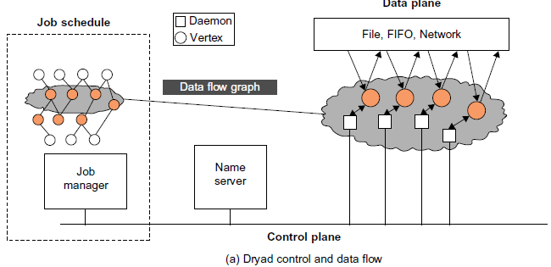

Slide 5
Dryad and Dryad LINQ from Microsoft
The job manager
1. Constructs a job’s communication graph (data flow graph) using the application-specific program provided by the user.
2. Collects the information required to map the data flow graph to the underlying resources (computation engine) from the name server.
Therefore, the job manager is able to:
1. Map the data flow graph to the underlying resources.
2. Schedule all necessary communications and synchronization across the respective resources.

Slide 6
Dryad and Dryad LINQ from Microsoft
Figure 6.13(b) shows the Dryad 2D pipe job structure.
During 2D pipe execution, Dryad defines many operations to construct and change the DAG dynamically.
The operations include creating new vertices, adding graph edges, merging two graphs, as well as handling job input and output. Dryad also has a fault-tolerant mechanism built in.
As it is built on a DAG, there are typically two types of failures: vertex failures and channel failures, which are handled differently.

Slide 7
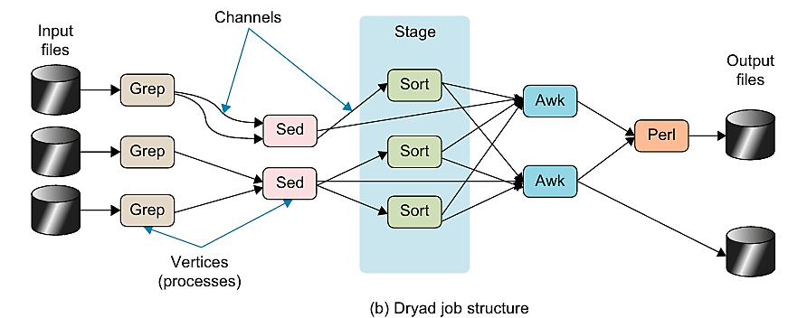

Slide 8
Dryad LINQ from Microsoft
DryadLINQ is built on top of Microsoft’s Dryad execution framework(http://research.microsoft.com/enus/projects/DryadLINQ/).
Dryad can perform acyclic task scheduling and run on large-scale servers.
The goal of DryadLINQ is to make large-scale, distributed cluster computing available to ordinary programmers.
Figure 6.14 shows the flow of execution with DryadLINQ.
The execution is divided into nine steps as follows:

Slide 9
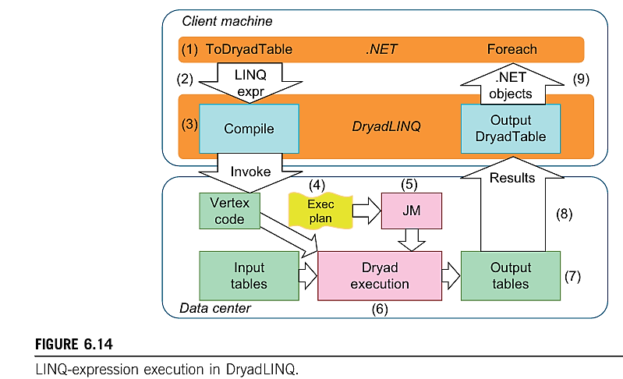

Slide 10
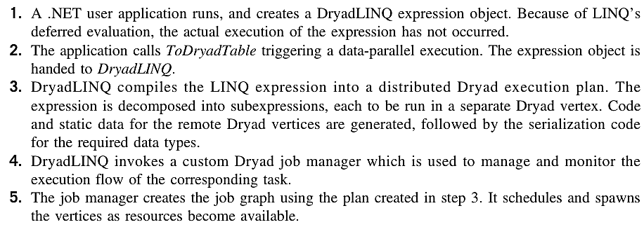
Dryad LINQ from Microsoft

Slide 11
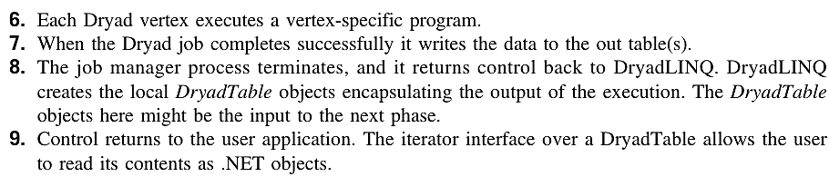
Dryad LINQ from Microsoft

Slide 12
Recollect Quiz
______________ is more flexible than MapReduce as the data flow of its applications is not dictated/predetermined and can be easily defined by users.
To achieve such flexibility, a Dryad program or job is defined by _____________.
This logical computation graph will be automatically mapped onto the physical nodes by the ______________.
A _______________ is controlled by the job manager, which is responsible for deploying the program to the multiple nodes in the cluster.
The two types of failures in Dryad are ______________ and _______________.
Notes:
Dryad
Directed Acyclic Graph (DAG)
Dryad runtime
Dryad Job
vertex failures and channel failures

Slide 13
Possible Questions in the IAT/Exam
What are the components and architecture of Dyrad? Briefly explain.
Briefly explain the Dryad 2D pipe job structure
Briefly explain the nine steps in the flow of execution with DryadLINQ.\
Briefly explain the role of a job manager.

Slide 14
THANK YOU

